Slide 1


Slide 2

Business Problem & Objective
Telecommunication providers are losing recurring revenue to churn, with 7,043 total customers and a churn rate of 26.54%—the core business challenge highlighted by this analysis. With average monthly charges of $64.76, even a small reduction in churn can meaningfully improve retention and lifetime value.
Problem
Primary Objectives
Business Impact
A 26.54% churn rate means nearly 1 in 4 customers are leaving, creating avoidable revenue loss and higher acquisition costs.
Understand which customers are at highest risk of leaving
Quantify feature-level churn drivers (tenure, charges, contract)
Deliver concrete retention recommendations tied to business levers
Lower churn by targeting high-risk cohorts, improving retention programs, and optimizing offers tailored to customer segments.

Slide 3
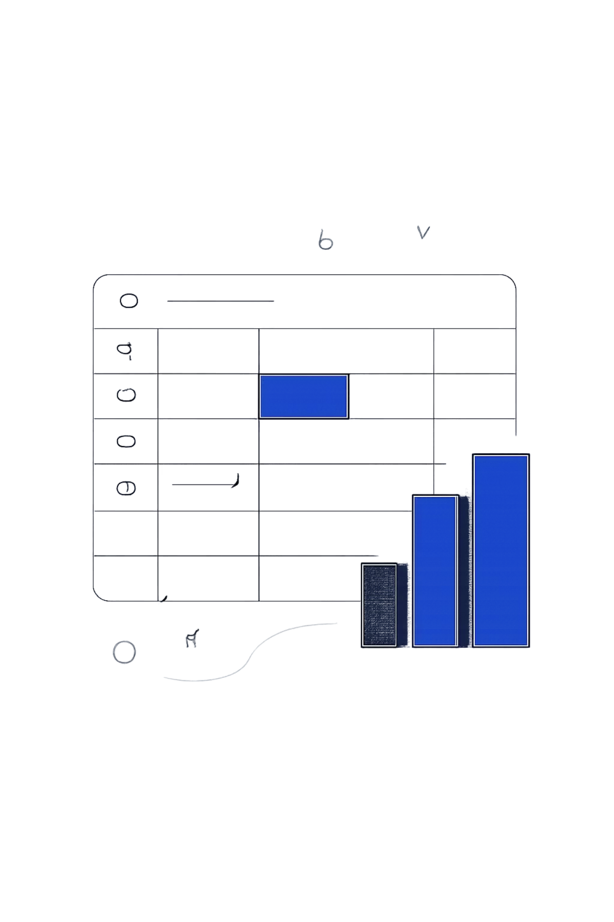
Dataset Overview
This analysis uses a telco customer dataset curated and validated for modeling and reporting. The dataset supports both descriptive analytics and predictive modeling.
Size & Composition
7,043 customers | 21 features. Churn: 1,869; Non-churn: 5,174 — sufficient class balance for training with stratification.
Key Variables
Tenure, Contract Type, Internet Service, Payment Method, Monthly Charges, Total Charges (plus demographic & service indicators).
Data Quality Notes
Missing values in TotalCharges corrected; types standardized for SQL joins and Python pipelines. Final dataset shape: 7043 rows × 21 columns.

Slide 4






Tools & Technologies
A pragmatic stack was used to move from raw data to business-ready insights. Each tool played a specific role in extraction, transformation, modeling, and visualization.
PostgreSQL
Python & Pandas
Matplotlib
Tableau Public
ETL, cohort queries, contract- and payment-segmentation, and aggregated feature engineering via SQL views.
Data cleaning, feature engineering, modeling pipeline, and model interpretation (coefficients, odds ratios).
Exploratory visuals for distributions, tenure vs churn, and monthly charges comparisons.
Interactive dashboard for executives and product managers: KPI cards, filters, and cohort-level drilldowns.
Excel
Scikit-Learn
Ad-hoc analysis, pivot checks, and stakeholder-ready exports.
Logistic Regression model, cross-validation, and performance evaluation.

Slide 5
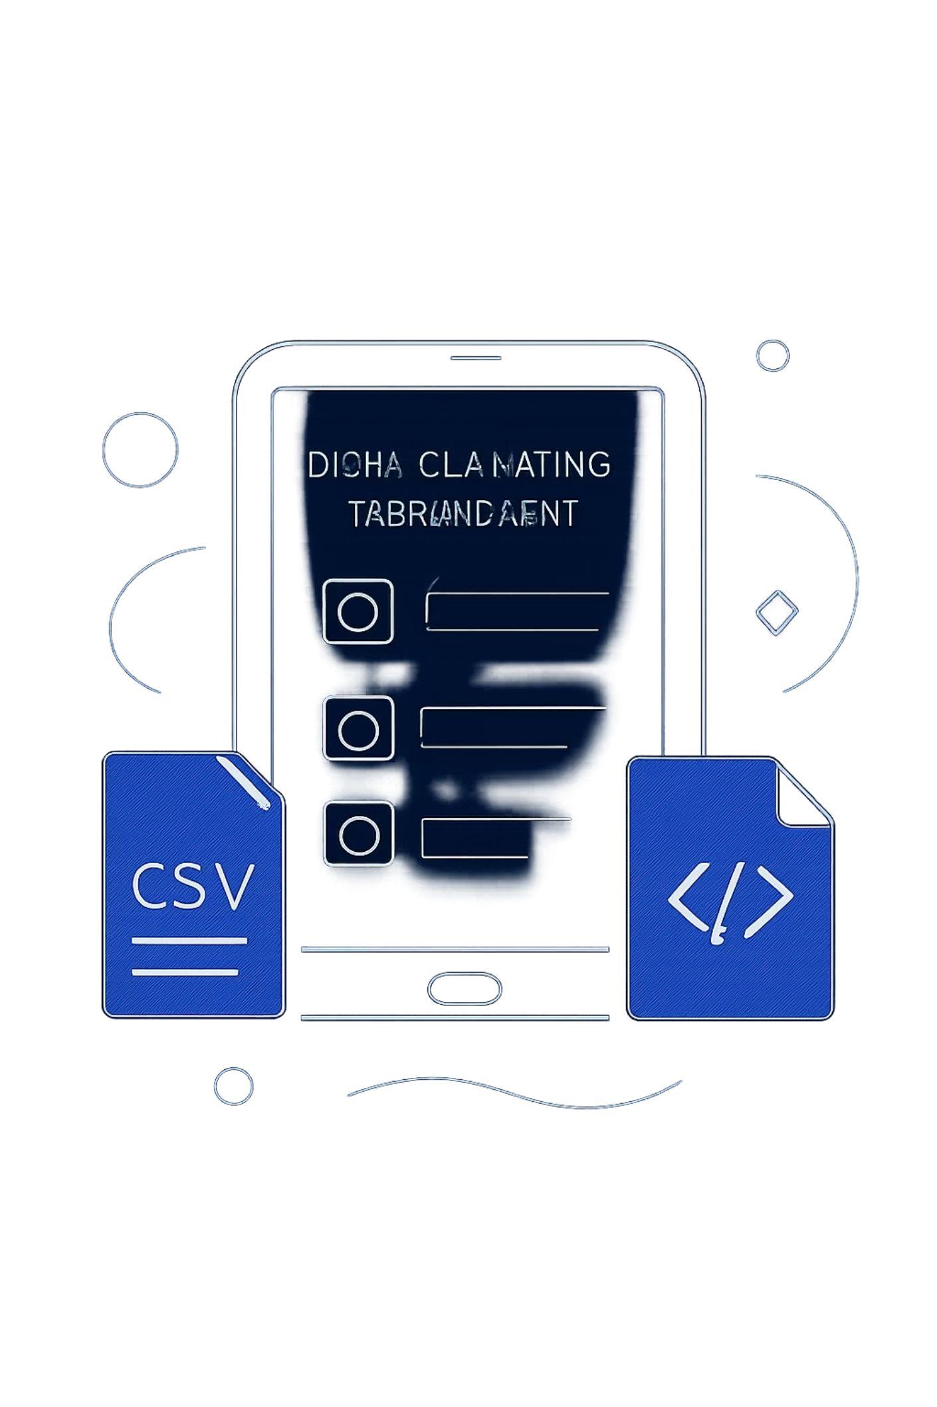
Data Cleaning & Preparation
A robust cleaning process ensured model-ready inputs and reliable analytics.
01
Missing Value Analysis
Identified nulls in TotalCharges and categorical fields. Imputed, validated, and documented assumptions for each imputation step.
02
Type Conversion
Converted TotalCharges from string to numeric after cleaning whitespace and placeholder values; ensured MonthlyCharges numeric.
03
Feature Engineering
Derived tenure buckets, binary flags for contract types (month-to-month, one-year, two-year), and payment method indicators (electronic check vs others).
04
Validation & Export
Ran row counts, unique value checks, and sample joins. Final dataset exported for modeling: 7043 rows × 21 columns.

Slide 6
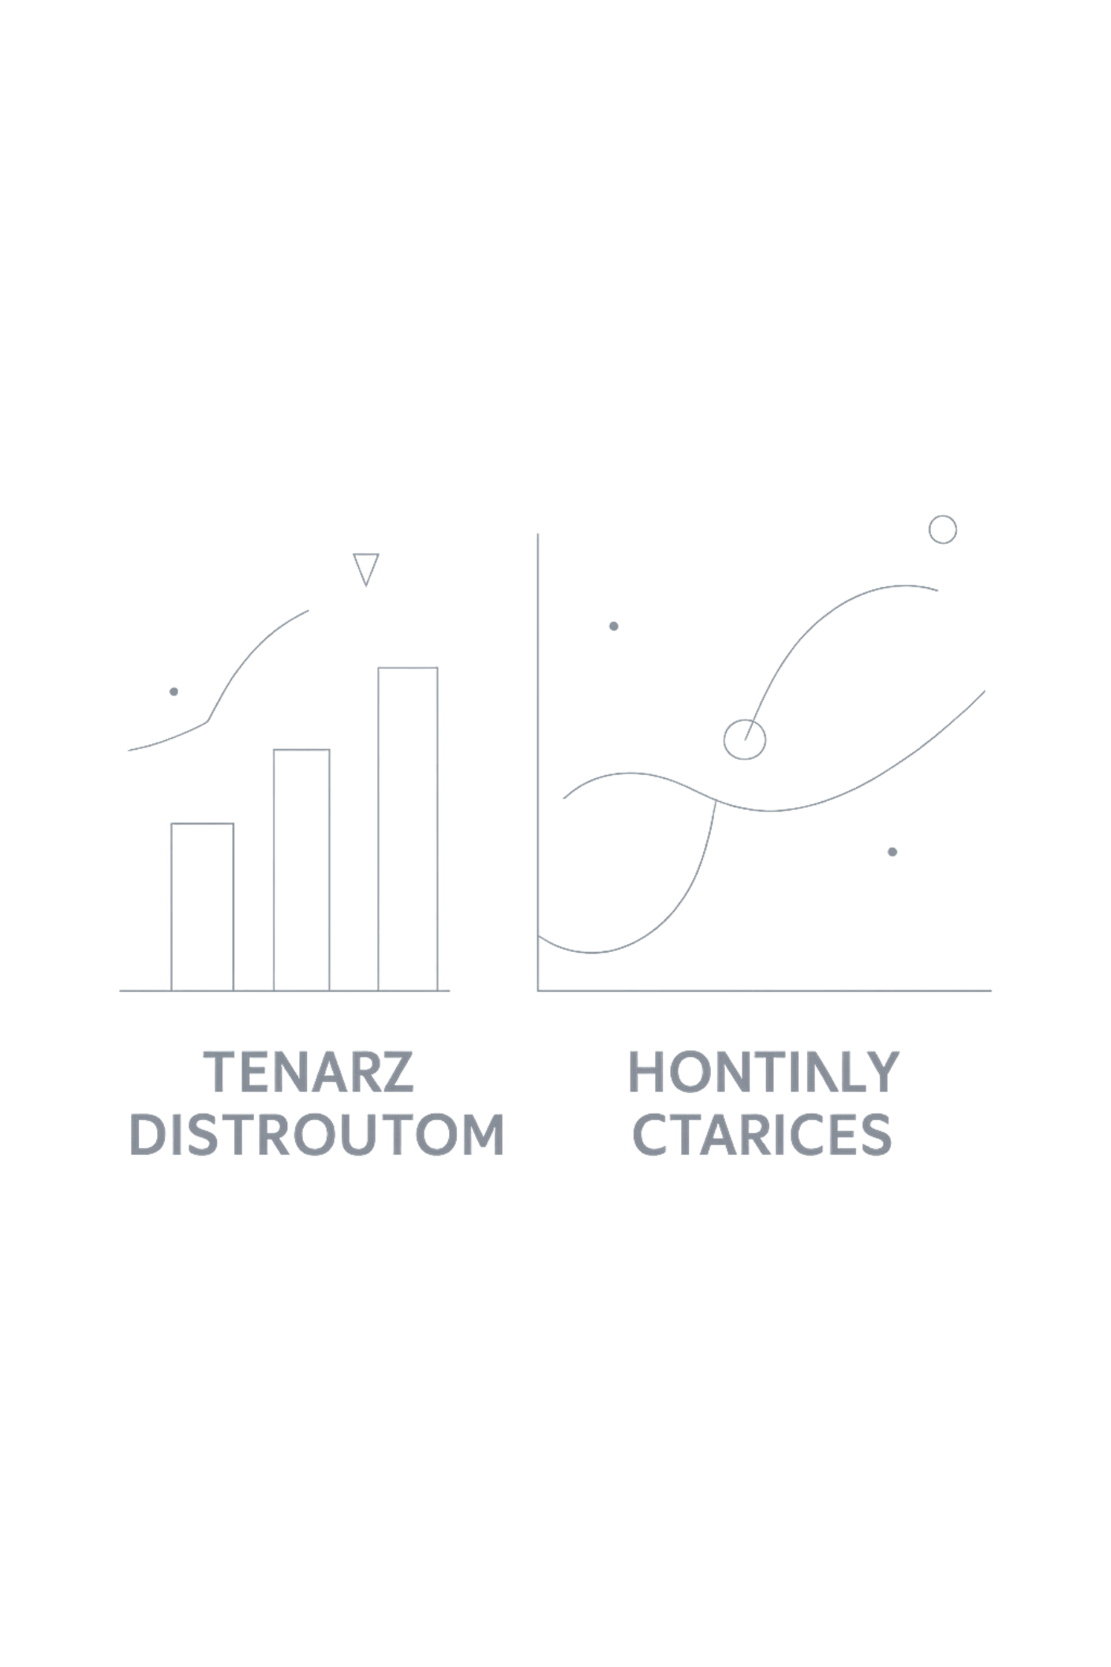


Exploratory Data Analysis — Key Findings
EDA highlighted behavioral and billing patterns strongly associated with churn. Visualizations (histograms, boxplots, and cohort charts) were used to surface patterns and guide feature selection for modeling.
Tenure
Contract Type
Churners average 17.98 months of tenure versus 37.57 months for non-churners, showing that churn is concentrated in earlier lifecycle stages.
Month-to-month accounts have 1,655 churners, compared with 1,307 for one-year contracts and 1,647 for two-year contracts.
Internet Service
Payment Method
Fiber optic shows 1,799 churners, while DSL has 1,962 and no internet has 1,413, indicating service type remains a meaningful churn driver.
Electronic check has 1,071 churners, the highest of all payment methods, while the others range from 308 to 258 churners.
EDA visuals informed feature engineering and validated model assumptions — charts included in the project notebook and Tableau dashboard for stakeholder review.

Slide 7

SQL Business Analysis Highlights
SQL queries enabled fast, repeatable business analyses used in dashboards and to create model-ready aggregations. Queries were translated into views for downstream use.
Contract vs Churn
Internet Service Comparison
Month-to-month customers show the highest churn rates: 2,220 total, with 1,655 churn. One year has 1,307 total, with 1,307 churn. Two year has 1,647 total, with 1,647 churn.
DSL has 1,962 churn, Fiber optic has 1,799 churn, and No internet has 1,413 churn.
Payment Method Analysis
Electronic check users have 1,294 total, with 1,071 churn. Mailed check has 1,304 total, with 308 churn. Bank transfer has 1,286 total, with 258 churn. Credit card has 1,290 total, with 232 churn.

Slide 8


Machine Learning Model — Logistic Regression
A transparent, interpretable logistic regression model was trained to predict customer churn. Emphasis was placed on stability, interpretability, and business translation of coefficients.
Features Included
Performance
Tenure, MonthlyCharges, TotalCharges, Contract (encoded), InternetService (encoded), PaymentMethod (encoded), and selected interaction terms. Feature scaling applied where appropriate.
Model accuracy: dashboard-aligned KPI (evaluated using stratified cross-validation). Additional metrics include precision, recall, and ROC-AUC captured in model report for threshold selection.
Interpretation
Month-to-month contracts have the highest churn risk, with a 74.5% churn rate. Fiber optic customers show elevated churn, and electronic check payment method correlates with higher churn at 82.8%. Tenure remains protective: longer tenure significantly reduces churn probability.
Model outputs are exported as a scored table for Tableau and for targeted retention campaign lists to be executed by CRM teams.

Slide 9



Tableau Dashboard & Operationalization
An executive dashboard was created to operationalize insights and enable drill-down analysis for product, marketing, and retention teams.
KPI Cards
Contract & Service Analysis
Interactivity
Top-level metrics: Overall churn rate, monthly churn trend, average tenure, and average monthly charges; refreshable from production views.
Drill-to-customer lists, exportable scored cohorts, and scenario filters for “what-if” retention simulations (e.g., impact of reducing monthly bill by 10% for high-risk fiber customers).
Visual segmentation by contract type, internet service, and payment method with filters for region and tenure bucket to identify priority cohorts.

Slide 10

Key Insights & Recommendations
Synthesis of dashboard-backed analytics and model outputs into recommended actions that balance short-term retention lift and longer-term customer experience investments.
Contract Type
Service & Experience
Payment Method
Tenure
Month-to-month customers have the highest churn rate at 74.5% (1,655 of 2,220). Prioritize converting these customers to 12- or 24-month contracts with targeted renewal incentives.
Fiber optic customers account for 1,799 churners, making service quality a critical retention lever. Focus on network reliability, proactive issue resolution, and priority support for at-risk fiber users.
Electronic check users show an 82.8% churn rate (1,071 of 1,294). Implement automated billing reminders, autopay enrollment, and alternative payment options to reduce billing friction.
Churners average 17.98 months of tenure versus 37.57 months for non-churners, a gap of 19.59 months. The early lifecycle is the most critical window for intervention.
Action Plan
Launch retention campaigns for month-to-month, fiber, and electronic check cohorts using model scores to prioritize outreach.
Test conversion offers: contract upgrades, bill credits, and autopay enrollment incentives to identify the lowest-cost retention lift.
Build a first-90-days intervention program with onboarding check-ins, service quality monitoring, and proactive support for new customers.
Push daily scored exports into CRM and review churn drivers monthly so messaging and offers can be adjusted quickly.
Expected outcome: lower monthly churn through targeted contract conversion, billing automation, and early-life retention interventions.

Slide 11


Thank You
This initiative combined SQL, Python, Machine Learning, and Tableau to identify churn drivers, prioritize at-risk segments, and enable measurable retention programs. The solution is designed to be scalable, explainable, and directly tied to business outcomes.
Key Deliverables
Data pipeline & curated analytics schema (SQL)
Feature engineering & predictive model suite (Python)
Interactive dashboards and risk operationalization (Tableau)
Playbook for targeted retention and measurement
Next Steps
Execute pilot retention campaign on top risk cohort
Track lift and iterate on interventions
Monitor model performance and retrain quarterly
Questions & Discussion — happy to walk through the model, the dashboard, or the operational rollout plan.

